Slide 1

Forecasting Workshop
www.linkedin.com/in/filotas-theodosiou
www.linkedin.com/in/filotas-theodosiou
Filotas Theodosiou
Contact Details:
- filotas.theodosiou@vives.be
- www.linkedin.com/in/filotas-theodosiou

Slide 2

Why do we Forecast?
“Planning is bringing the future into the present so you can do something about it now”
We want to predict the future in order to act now
In that sense: Forecasting is used as a tool to assist in decision making
King Algeus in front of Pythia at the Oracle of Delphi, 440-430 BC
More formally:
Find best action α that minimizes the expected cost depending on the action and the forecast
Examples:
Forecast the weather to optimize agriculture planning
Forecast the number of tourists to prepare summer investments and workforce

Slide 3
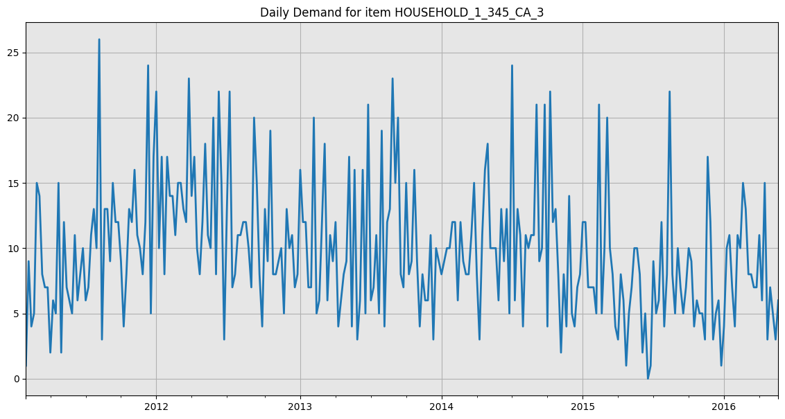
Why do we Consider Forecasting Systems?
Quick answer: Quick and effective assistance in our Decision Making.
Example: Inventory Replenishment
But…
What about our managers?
What about our years of experience?

Slide 4
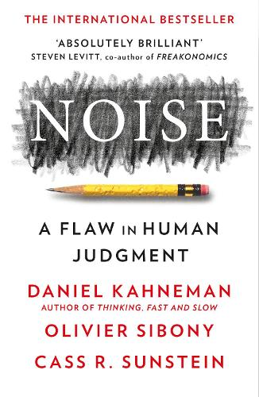
Why do we Consider Forecasting Systems?
Quick answer: Quick and effective assistance in our Decision Making.
Example: Inventory Replenishment
But…
What about our managers?
What about our years of experience?
Biases & Noises*
Kahneman, Daniel, Olivier Sibony, and Cass R. Sunstein. Noise: a flaw in human judgment. Hachette UK, 2021.

Slide 5
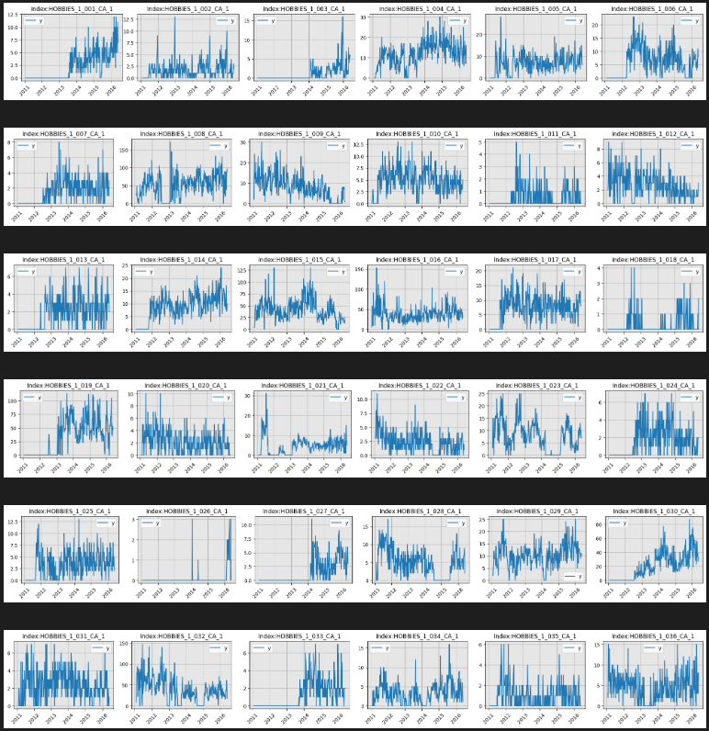
Why do we Consider Forecasting Systems?
Quick answer: Quick and effective assistance in our Decision Making.
Example: Inventory Replenishment
But…
What about our managers?
What about our years of experience?
Biases & Noises*
Limited brain capacity
Kahneman, Daniel, Olivier Sibony, and Cass R. Sunstein. Noise: a flaw in human judgment. Hachette UK, 2021.

Slide 6
How to Approach Forecasting
The Forecasters Pipeline
Clearly Define
Your Business Task
Understand
Your Data
Design an Evaluation Protocol
Build a Baseline Forecasting Model
Evaluate
Steadily Increase Model Complexity
Is the forecast good enough?

Slide 7
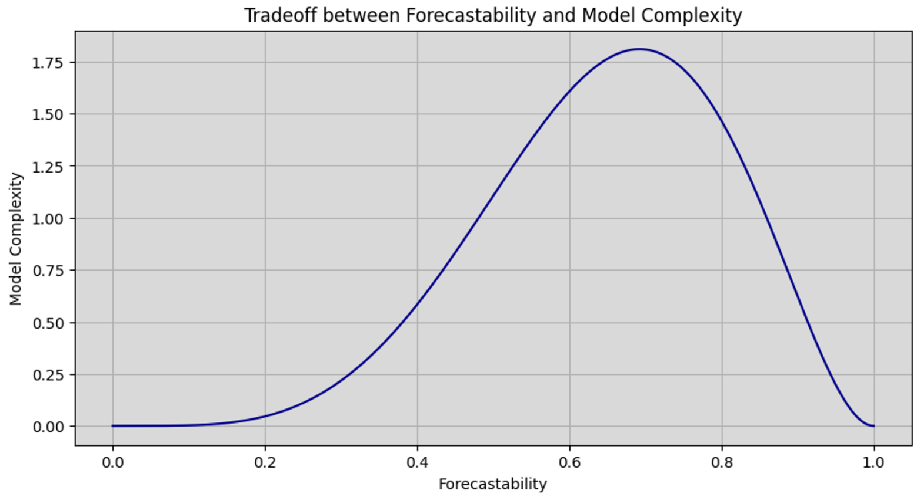
So.. Whats Forecasting?
Forecasting is the prediction of future values of a time series using the known past values and/or some other related variables.
What can we forecast?
Weather tomorrow
Lottery number next Sunday
The stock price of Tesla next Friday
Model Selection:
Establish strong baseline benchmarks
Steadily increase complexity until you reach good enough accuracy
Dont use a bazooka for a a small ant.

Slide 8
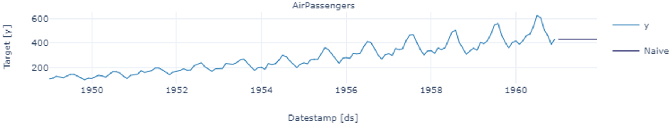
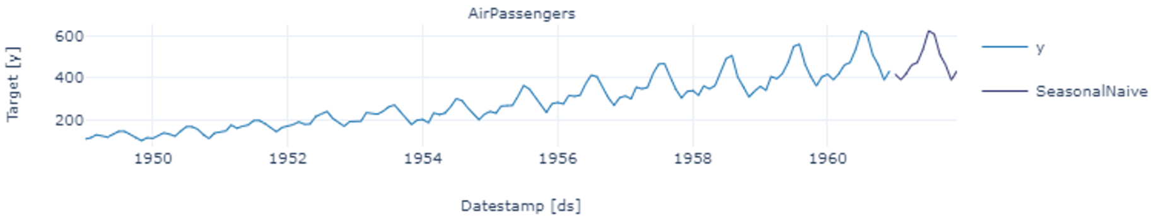
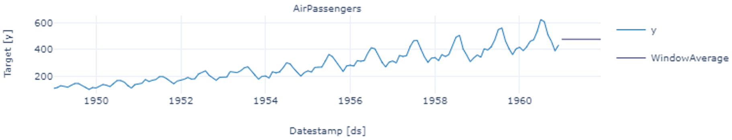
Statistical Models in a Nutshell: Part 1
Strong Baselines with 0 tunable parameters.
Naïve: Forecasts are equal to the last observation
Seasonal Naïve: Forecasts equal to the last observation from the same season (eg same month last year)
Window Moving Average: Average of the last k observation

Slide 9
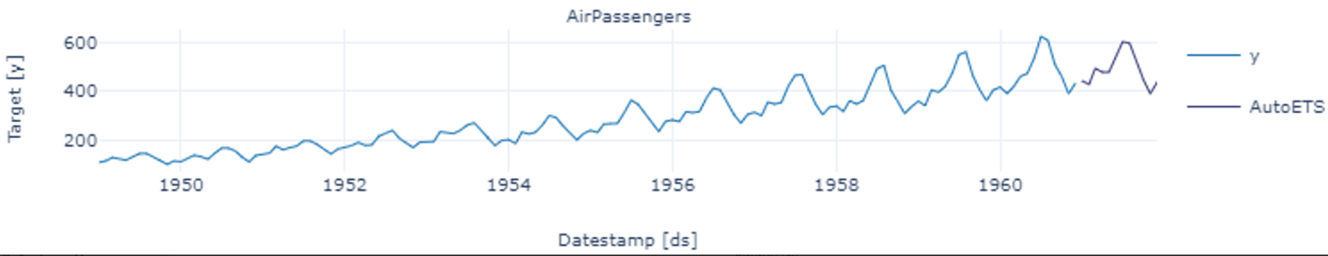
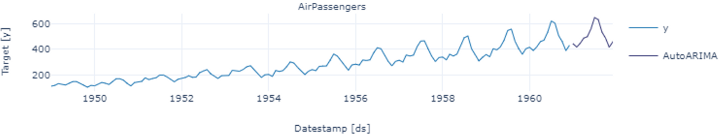
Statistical Models in a Nutshell: Part 2
Classical Statistical Models with a low number of tunable parameters
Exponential Smoothing (ETS): Forecasts are weighted averages of past observations with weights decaying exponentially as observations get older.
There is a big family of ETS methods to forecast time series with different types of trend and/or seasonalities
AutoRegressive Integrated Moving Average (ARIMA): Forecasts are obtained by performing d order differencing (to ensure stationarity) and then considering the last p terms and last q moving average terms.

Slide 10
Implementation Time
www.linkedin.com/in/filotas-theodosiou
www.linkedin.com/in/filotas-theodosiou
Jump to the Notebook
Filotas Theodosiou
Contact Details:
- filotas.theodosiou@vives.be
- www.linkedin.com/in/filotas-theodosiou

Slide 11
Forecasting with Machine Learning (ML)

Slide 12
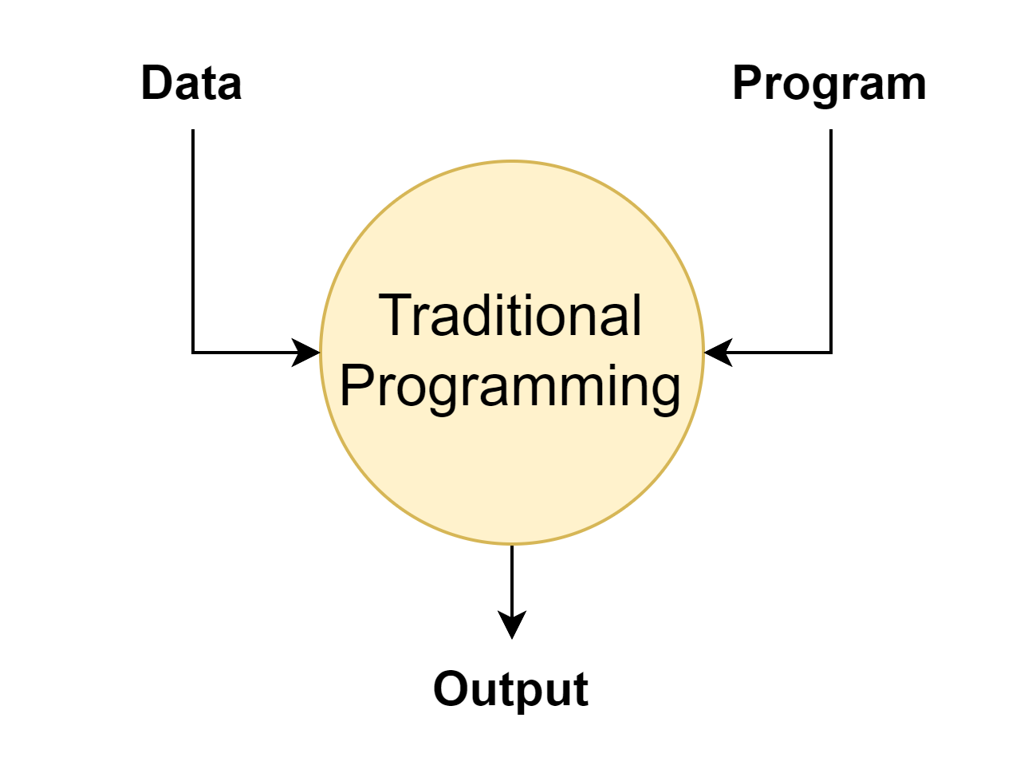
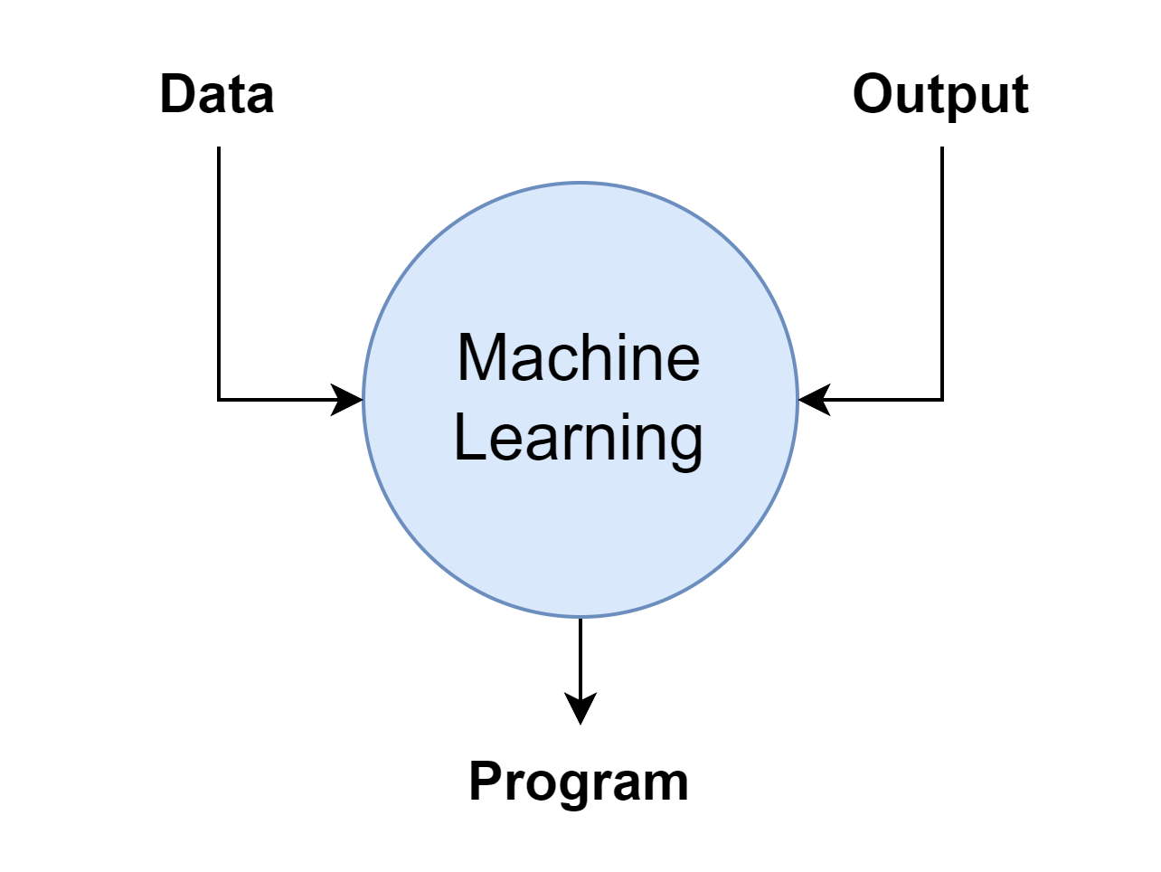
Understanding the … basics of ML
Focus on Supervised Learning:
Learn from data and come up with a set of rules/logic, a function.

Slide 13

Understanding the … basics of ML
Focus on Supervised Learning:
Learn from data and come up with a set of rules/logic, a function.
Target (known)
Step 1: Learn the ideal function g
$$y=g(X)$$
Ideal target function(unknown)

Slide 14

Understanding the … basics of ML
Focus on Supervised Learning:
Learn from data and come up with a set of rules/logic, a function.
Target (known)
Step 1: Learn the ideal function g
$$y=g(X)$$
Ideal target function(unknown)
Predicted target
Features (known)
$$\hat{y}=h(X,φ)$$
Step 2: Perform inference (predictions)
Approximation of the ideal function
Model parameters

Slide 15




Understanding the … basics of ML
Focus on Supervised Learning:
Learn from data and come up with a set of rules/logic, a function.
Target (known)
Step 1: Learn the ideal function g
$$y=g(X)$$
Ideal target function(unknown)
Predicted target
Features (known)
$$\hat{y}=h(X,φ)$$
Step 2: Perform inference (predictions)
Approximation of the ideal function
Model parameters
$$y=g(X)$$
Training
Putting it all together:
$$D(x_{i}, y_{i})$$
Loss function
$$\hat{y}=h(X,φ)$$

Slide 16
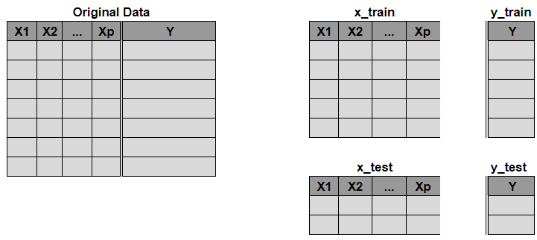
From a Forecasting to a Regression Task.
Your typical ML data input:

Slide 17

From a Forecasting to a Regression Task.
Your typical ML data input:
Your typical time series format:

Slide 18
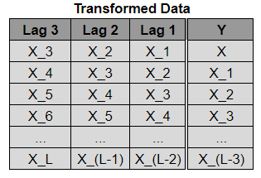
From a Forecasting to a Regression Task.
Your typical ML data input:
Your typical time series format:
Sliding window k
Window Transformation

Slide 19
From a Forecasting to a Regression Task.
Your typical ML data input:
Your typical time series format:
Sliding window k
Window Transformation

Slide 20
From a Forecasting to a Regression Task.
Your typical ML data input:
Your typical time series format:
Sliding window k
Lag Selection:
Ideally Y should be conditioned on all past observations
In reality this is not possible
Sliding window k is a hyperparameter to be tuned
Window Transformation

Slide 21


Machine Learning Forecasting Models
$$\hat{y}=\sum_{i=1}^{k}{X_{i}β_{i}}$$
1) Linear Regression:
Statistical rather than ML method
Estimate parameters through OLS
Attention on the required assumptions
Low complexity, linear method
3) Random Forest
Ensemble method using multiple decision trees
Splits feature space and uses Bagging
Very good results but prone to overfitting
Medium complexity
2) Regularized (LASSO) Regression:
Statistical rather than ML method
Regularizes coefficients acting as internal feature selection method
Weights of non important feaures are shrinked to zero
Low complexity, linear method
$\hat{y}=\sum_{i=1}^{k}{X_{i}β_{i}}+$ $\sum_{i=1}^{k}{|β_{i}|}$

Slide 22
Machine Learning Forecasting Models
4) Gradient Boosted Decision Trees – XGBoost, LGBM
Ensemble method using multiple decision trees
Splits feature space and uses Boosting
State of the art (SOTA) results if tuned properly
Medium - High complexity
6) Specialized Neural Network Architectures
Deep Learning methods with unique architectures
Architectures optimized by researchers
DeepAR, N-BEATS, TFT, etc
Very good/SOTA results if used on the right tasks
5) Neural Networks
Deep Learning method based on Gradient Descent
Relies on the encoder-decoder paradigm
Architecture varies (FFNs, RNNs, LSTMs, CNNs, TCNs)
Complexity/results vary based on the architecture

Slide 23
Implementation Time
www.linkedin.com/in/filotas-theodosiou
www.linkedin.com/in/filotas-theodosiou
Jump to the Notebook
Filotas Theodosiou
Contact Details:
- filotas.theodosiou@vives.be
- www.linkedin.com/in/filotas-theodosiou

Slide 24
Global Learning: A key moment

Slide 25
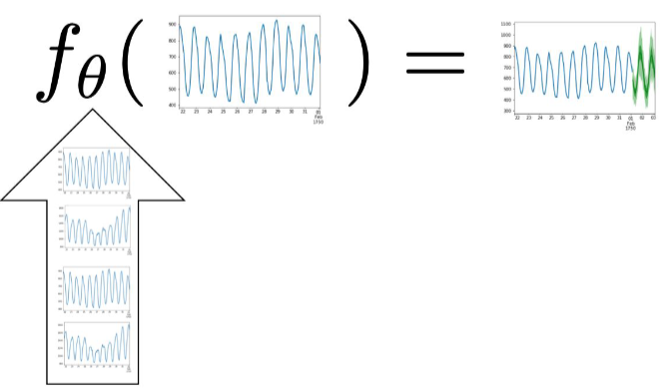
The missing key to the puzzle
Time series A
Local Learning: A model per time series
Most “traditional” approaches.
Computational issues
10000 models for 10000 time series?
Models of limited capacity.
Many time series have limited historical values to properly fit a model
Limited data ⬄ Limited number of parameters ⬄ “Simpler” Models.
Montero-Manso, Pablo, and Rob J. Hyndman. "Principles and algorithms for forecasting groups of time series: Locality and globality." International Journal of Forecasting 37.4 (2021): 1632-1653.
Gasthaus. Jan & Januschowski , Tim. “Modern Forecasting in Practise, Session 1”, Sphere Online Course. URL: https://www.getsphere.com/cohorts/modern-forecasting-in-practice

Slide 26

The missing key to the puzzle
Time series A
Local Learning: A model per time series
Most “traditional” approaches.
Computational issues
10000 models for 10000 time series?
Models of limited capacity.
Many time series have limited historical values to properly fit a model
Limited data ⬄ Limited number of parameters ⬄ “Simpler” Models.
Global Learning: A paradigm shift.
Increase the width and not the length
Allow for higher capacity models (NNs, GBDTs, etc..)
Theoretical evidence for improved performance
Time series B
Time series C
Time series D
Time series E
Time series A
Time series B
Time series C
Time series D
Time series E
Width
Length
Montero-Manso, Pablo, and Rob J. Hyndman. "Principles and algorithms for forecasting groups of time series: Locality and globality." International Journal of Forecasting 37.4 (2021): 1632-1653.
Gasthaus. Jan & Januschowski , Tim. “Modern Forecasting in Practise, Session 1”, Sphere Online Course. URL: https://www.getsphere.com/cohorts/modern-forecasting-in-practice

Slide 27
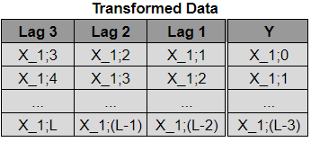
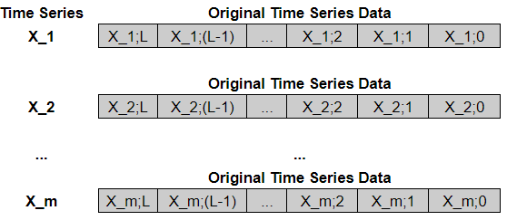
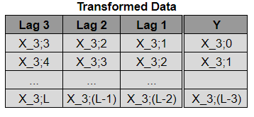
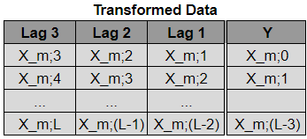
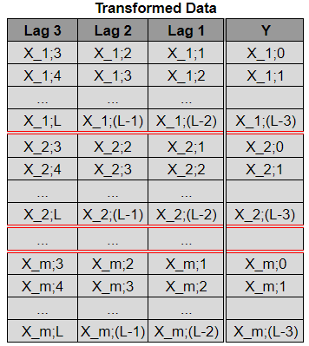
Global vs Local Forecasting
Assume we have to forecast m time series
Train a unique model
Train a unique model
Local Learning:
Train a unique model
Global Learning:
Train a single model

Slide 28
Benefits of Global Learning
The circumstances where global learning excels is an ongoing research field
Known Benefits:
Increased sample size (In general more data => higher accuracy)
Cross learning (Explore similarities between time series to learn patterns better)
Reduced complexity
Handles edge cases (eg cold start)

Slide 29
Implementation Time
www.linkedin.com/in/filotas-theodosiou
www.linkedin.com/in/filotas-theodosiou
Jump to the Notebook
Filotas Theodosiou
Contact Details:
- filotas.theodosiou@vives.be
- www.linkedin.com/in/filotas-theodosiou

